Slide 1
CPSC131
Matrix Math
and
Gaussian Elimination

Slide 2
Objectives
Understanding matrix notation.
Being able to identify the following types of matrices: identity, diagonal, symmetric, and triangular.
Knowing theorems of matrices how to perform matrix multiplication and being able to assess when it is feasible.
Knowing how to represent a system of linear equations in matrix form.
Knowing how to solve linear algebraic equations with Gaussian elimination.

Slide 3
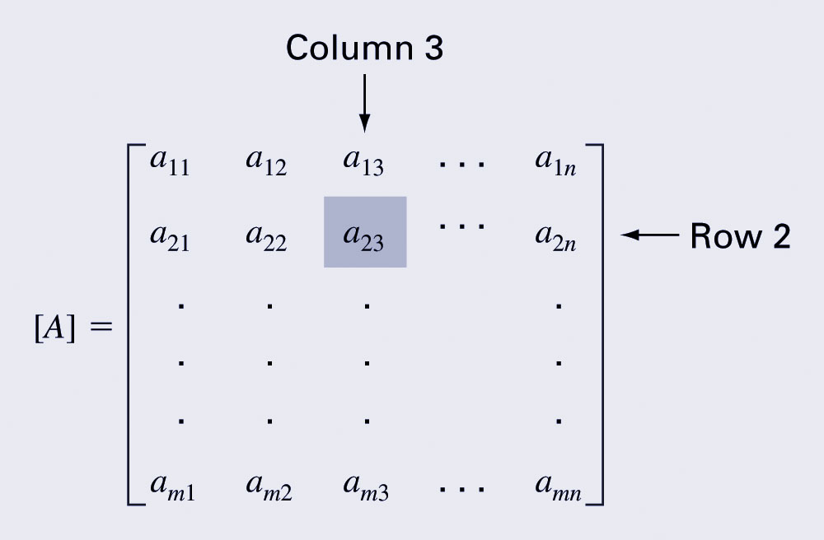
A matrix consists of a rectangular array of elements represented by a single symbol (example: [A]).
An individual entry of a matrix is an element (example: a₂₃)

Slide 4
The horizontal lines in a matrix are called rows
The vertical lines are called columns
A matrix with m rows and n columns is called an m by n matrix
m and n are called its dimensions
The dimensions of a matrix are always given with the number of rows first, then the number of columns. The order or size of the matrix is m x n
1 x n matrices are called row vectors
m x 1 matrices are called column vectors
Matrix A is a 3 x 4 matrix. A_{(2,3)} = ?

Slide 5
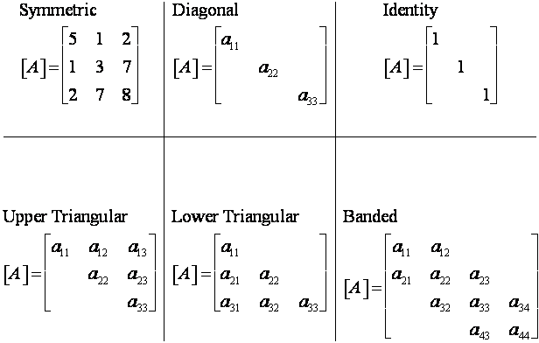
Special Matrices
Matrices where m=n are called square matrices.
There are a number of special forms of square matrices (‘missing’ elements are = 0) :

Slide 6
Matrix Operations
Two matrices are considered equal if and only if every element in the first matrix is equal to every corresponding element in the second. This means the two matrices must be the same size.
Matrix addition and subtraction are performed by adding or subtracting the corresponding elements. This requires that the two matrices be the same size.
Scalar matrix multiplication is performed by multiplying each element by the same scalar.

Slide 7
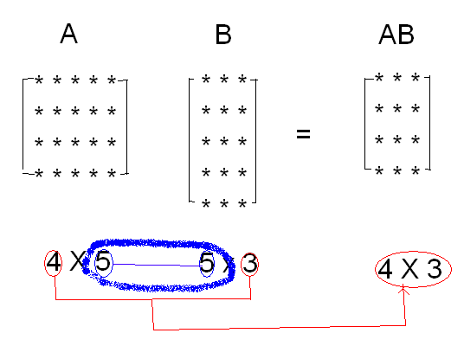
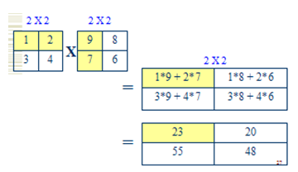
Matrix Multiplication (AB)
Matrices can be Multiplication of two matrices is defined only if the number of columns of the left matrix (A) is equal to the number of rows of the right matrix (B).
Note that a ‘dot’ is not used to indicate matrix multiplication. The dot is used for cell by cell multiplication.
A.*B =
AB =
1*9 + 2*7 = 23
3*9 + 4*7 = 55

Slide 8
AB is not equal to BA
A = 1 ; B= 3,4,1,5 ; AB = 3 4 1 5
2 6 8 2 10
0 0 0 0 0
1 3 4 1 5
(4 *1 ) ( 1*4) = ( 4*4)
BA = 3,4,1,5 1 = (3+8+5)=16
2
0
1 (1*4) (4*1) = (1*1 )

Slide 9
Theorem 1- Association law
If A,B, and C are the matrices of same size and let r and s be the scalars, then:
A+B= B+A
(A+B)+C=A+(B+C)
A+0=A
r(A+B)=rA+rB
r(sA)=(rs)A

Slide 10
Theorem 2- Distributive law
If A, B, and Cs are matrices and if the multiplication is applicable and r is scalor, then
A(BC)=(AB)C
A(B+C)=AB+AC
(B+C)A=BA+CA
r(AB)=(rA)B=A(rB)

Slide 11

Example of “Associative Law”
Let A= 1 2 , B= $\begin{matrix}3 & 4 \\ 2 & 1\end{matrix}$ , C= $\begin{matrix}3 & 0 & 2 \\ 5 & 1 & 0\end{matrix}$ prove that A(BC)=(AB)C
then AB= 1 2 $\begin{matrix}3 & 4 \\ 2 & 1\end{matrix}$ = 7 6
And BC = $\begin{matrix} 3 & 4 \\ 2 & 1\end{matrix}$ $\begin{matrix} 3 & 0 & 2 \\ 5 & 1 & 0 \end{matrix}$ = $\begin{matrix} 29 & 4 & 6 \\ 11 & 1 & 4\end{matrix}$
(AB)C = 7 6 $\begin{matrix}3 & 0 & 2 \\ 5 & 1 & 0\end{matrix}$ = 51 6 14
A(BC) = 1 2 $\begin{matrix} 29 & 4 & 6 \\ 11 & 1 & 4\end{matrix}$ = 51 6 14

Slide 12
Example of “Distributive Law”
A= 1,2 B= 3 4 C= 4 2
0 5 1 7
B+C= 7 6 , A(B+C)= 9,30
1 12
AB= 3,14
AC= 6,16 , AB+AC= 9,30
A(B+C)= AB+AC

Slide 13
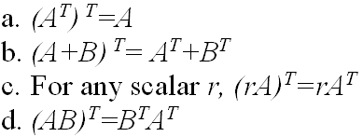
Example of the “Transpose”.
A= 1 3 A‘ = 1 2
2 5 3 5
A= 1 3 4 A’ = 1 0
0 1 0 3 1
4 0
It will be observed that if A is m x n, At is n x m
Theorem 3 , Transpose

Slide 14
Linear Systems
An equation of the form ax+by+c=0 or equivalently
ax+by=-c is called a linear equation in x and y variables.
ax+by+cz=d is a linear equation in 3 variables x, y, and z.
Thus, a linear equation in n variables is
a₁x₁+a₂x₂+ … +a_{n}x_{n} = b
A solution of such an equation consists of real numbers c₁, c₂, c₃, … , c_{n}. If you need to work more than one linear equation, a system of linear equations must be solved simultaneously.

Slide 15
Noncomputer Methods for Solving Systems of Equations
For small number of equations (n ≤ 3), linear equations can be solved readily by simple techniques such as “Method of Elimination.”
Simple algebra provides the tools to solve such systems of linear equations.
Easy access to computers makes the solution of large sets of linear algebraic equations possible and practical.

Slide 16
Solving Small Numbers of Equations
Many ways to solve a system of linear equations:
Graphical method
Method of elimination
Computer methods
Hand calculator
MATLAB
* In engineering, we generally use multiple solution methods to verify answers

Slide 17
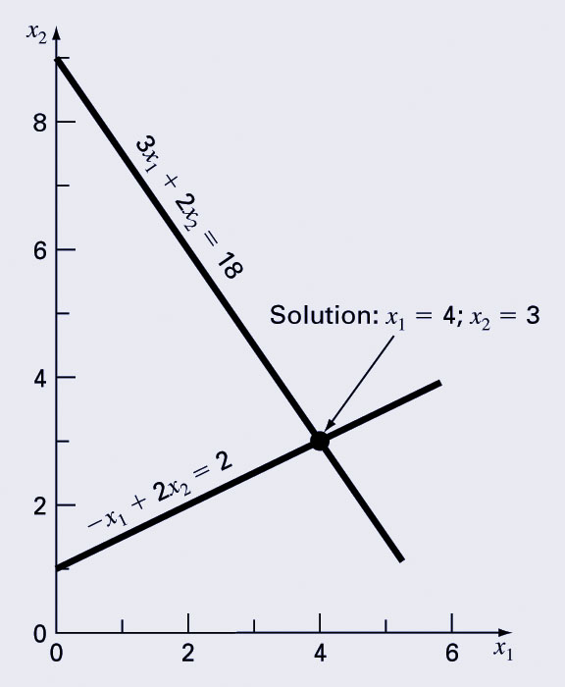
Graphical Method
For small sets of simultaneous equations, graphing them and determining the location of the intercept provides a solution.

Slide 18
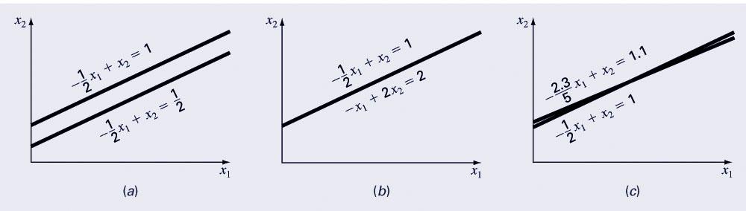
Graphing the equations can also show systems where:
No solution exists
Infinite solutions exist
System is ill-conditioned (slopes are so close it is hard to determine intersection point)

Slide 19
Method of Elimination
The basic strategy is to successively solve one of the equations of the set for one of the unknowns and to eliminate that variable from the remaining equations by substitution.
The elimination of unknowns can be extended to systems with more than two or three equations; however, the method becomes extremely tedious to solve by hand.

Slide 20
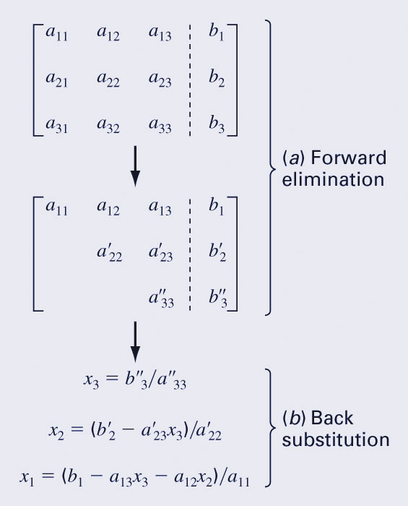
Naïve Gaussian Elimination (cont)
Forward elimination
Starting with the first row, add or subtract multiples of that row to eliminate the first coefficient from the second row and beyond.
Continue this process with the second row to remove the second coefficient from the third row and beyond.
Stop when an upper triangular matrix remains.
Back substitution
Starting with the last row, solve for the unknown, then substitute that value into the next highest row.
Because of the upper-triangular nature of the matrix, each row will contain only one more unknown.

Slide 21
Example
Use Gauss elimination to solve:
2x₁+ x₂ – x₃ = 0 Eq 1
x₁ – 2x₂ + 3x₃ = 11 Eq 2
– x₁ + 2x₂ + 2x₃ = –6 Eq 3
1) Forward elimination (use Eq1 to change E2 and E3): Eliminate x₁ from Eq 2
Multiply Eq 2 by -2 and add Eq 1
-2x₁ + 4x₂ - 6x₃ = -22 -2 x Eq 2
2x₁ + x₂- x₃ = 0 + Eq 1
5x₂ - 7x₃ = -22 new Eq 2
2) Forward elimination:
Eliminate x1 from Eq 3
Multiply Eq 3 by 2 and add Eq 1
-2x₁ + 4x₂ + 4x₃ = -12 -2 x Eq 3
2x₁ +x₂- x₃ = 0 + Eq 1
5x₂ +3x₃ = -12 new Eq 3
Our equations are now:
2x₁+ x₂ – x₃ = 0 Eq 1
5x₂ - 7x₃ = -22 new Eq 2
5x₂ + 3x₃ = -12 new Eq 3

Slide 22
2x₁+ x₂ – x₃ = 0 Eq 1
5x₂ - 7x₃ = -22 new Eq 2
5x₂ + 3x₃ = -12 new Eq 3
Forward elimination:
Now eliminate x₂ from new Eq 3
Subtract Eq2 from Eq 3
10x₃ = 10 newer Eq 3
Our equations are now:
2x₁+ x₂ – x₃ = 0 Eq 1
5x₂ - 7x₃ = -22 new Eq 2
10x₃ = 10 newer Eq 3
Therefore, x₃ = 1
Back substitute x₃ = 1 into new Eq 2:
5x₂ - 7(1) = -22 new Eq 2
5x₂ = -22 + 7 = -15
Therefore, x₂ = –3
Back substitute x₂ = –3 & x₃ = 1 into Eq 1:
2x₁+ x₂ – x₃ = 0 Eq 1
2x₁ + (–3) – 1 = 0
2x₁ = 4
Therefore, x₁ = 2
So, x₁ = 2, x₂ = –3 & x₃ = 1
(verify by substituting into each original equation)
2x₁+ x₂ – x₃ = 0 2(2) + -3 – 1 = 4 - 4 = 0
x₁ – 2x₂ + 3x₃ = 11 2 – 2(-3) + 3(1) = 2 + 6 + 3 = 11
– x₁ + 2x₂ + 2x₃ = –6 -2 + 2(-3) + 2(1) = -2 -6 + 2 = -6

Slide 23
Matrices are used to solve equations
Matrices provide a powerful notation for representing and solving simultaneous linear equations:
Then we can multiply both sides by the inverse matrix
And we can then know the values of X because

Slide 24
Example Find Inverse of A
Step 1 – Calc Determinant
Determinant (ad-cb) = 4x3-8x1 = 4
Step 2 – Swap Elements on leading diagonal
Step 3 – negate the other elements
Step 4 – multiply by 1/determinant

Slide 25
More inverses to find and check

Slide 26
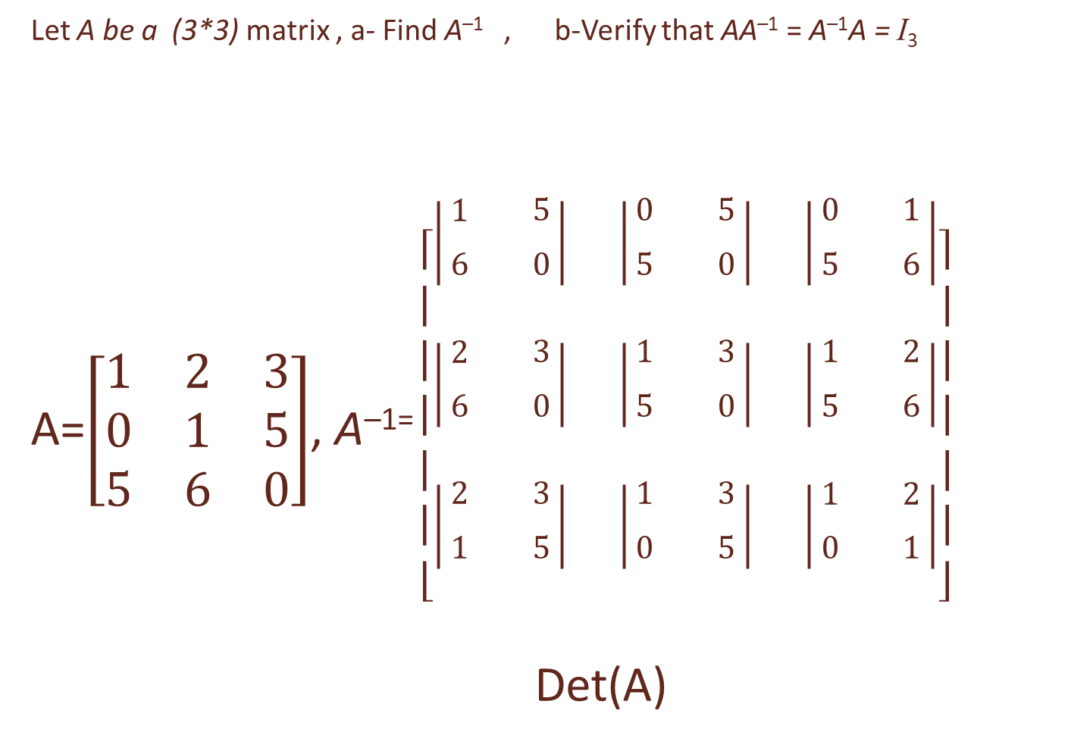
Let A be a (3*3) matrix , a- Find A^{–1} , b-Verify that AA^{–1} = A^{–1}A = I₃
A=$\left[\begin{matrix}1 & 2 & 3 \\ 0 & 1 & 5 \\ 5 & 6 & 0\end{matrix}\right]$, A^{–1=} $\left[\begin{matrix}\left|\begin{matrix}\begin{aligned} \\ 1\end{aligned} & \begin{aligned} \\ 5\end{aligned} \\ 6 & 0\end{matrix}\right| & \left|\begin{matrix}\begin{aligned} \\ 0\end{aligned} & \begin{aligned} \\ 5\end{aligned} \\ 5 & 0\end{matrix}\right| & \left|\begin{matrix}\begin{aligned} \\ 0\end{aligned} & \begin{aligned} \\ 1\end{aligned} \\ 5 & 6\end{matrix}\right| \\ \left|\begin{matrix}\begin{aligned} \\ 2\end{aligned} & \begin{aligned} \\ 3\end{aligned} \\ 6 & 0\end{matrix}\right| & \left|\begin{matrix}\begin{aligned} \\ 1\end{aligned} & \begin{aligned} \\ 3\end{aligned} \\ 5 & 0\end{matrix}\right| & \left|\begin{matrix}\begin{aligned} \\ 1\end{aligned} & \begin{aligned} \\ 2\end{aligned} \\ 5 & 6\end{matrix}\right| \\ \left|\begin{matrix}\begin{aligned} \\ 2\end{aligned} & \begin{aligned} \\ 3\end{aligned} \\ 1 & 5\end{matrix}\right| & \left|\begin{matrix}\begin{aligned} \\ 1\end{aligned} & \begin{aligned} \\ 3\end{aligned} \\ 0 & 5\end{matrix}\right| & \left|\begin{matrix}\begin{aligned} \\ 1\end{aligned} & \begin{aligned} \\ 2\end{aligned} \\ 0 & 1\end{matrix}\right|\end{matrix}\right]$
Det(A)

Slide 27

$\left[\begin{matrix}−30 & −25 & −5 \\ −18 & −15 & −4 \\ 7 & 5 & 1\end{matrix}\right]$= $\left[\begin{matrix}−30 & 25 & −5 \\ 18 & −15 & 4 \\ 7 & −5 & 1\end{matrix}\right]$ = $\left[\begin{matrix}−30 & 18 & 7 \\ 25 & −15 & −5 \\ −5 & 4 & 1\end{matrix}\right]$
5 5 5
A^{–1} =$\left[\begin{matrix}−6 & 3.6⋯ & 1.4 \\ 5 & −3 & −1 \\ −1 & 0.8 & 0.2\end{matrix}\right]$
A^{–1 .}A =I

Slide 28
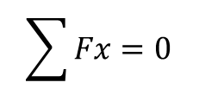
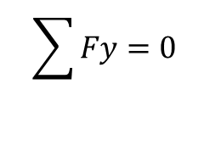
Solve using matrices using
Q1- 2 X₁ + X₂ -x3=0
X₁ -2 X₂ +3 X₃ =11
- X₁ +2 X₂ +2 X₃ =-6
Ans: X₁ = 2, X₂ = –3 & X₃ = 1
Y
$$\sum{Fy}=0$$
$$\sum{Fx}=0$$
F1
12 KN
F1 cos 45 +F2 cos 35 -12 cos 30=0
F1 sin 45 + 12 sin 30 – F2 sin 35 = 0
Ans: F1=2.06, F2=11.76
30
45
x
35
F2

